Slide 1
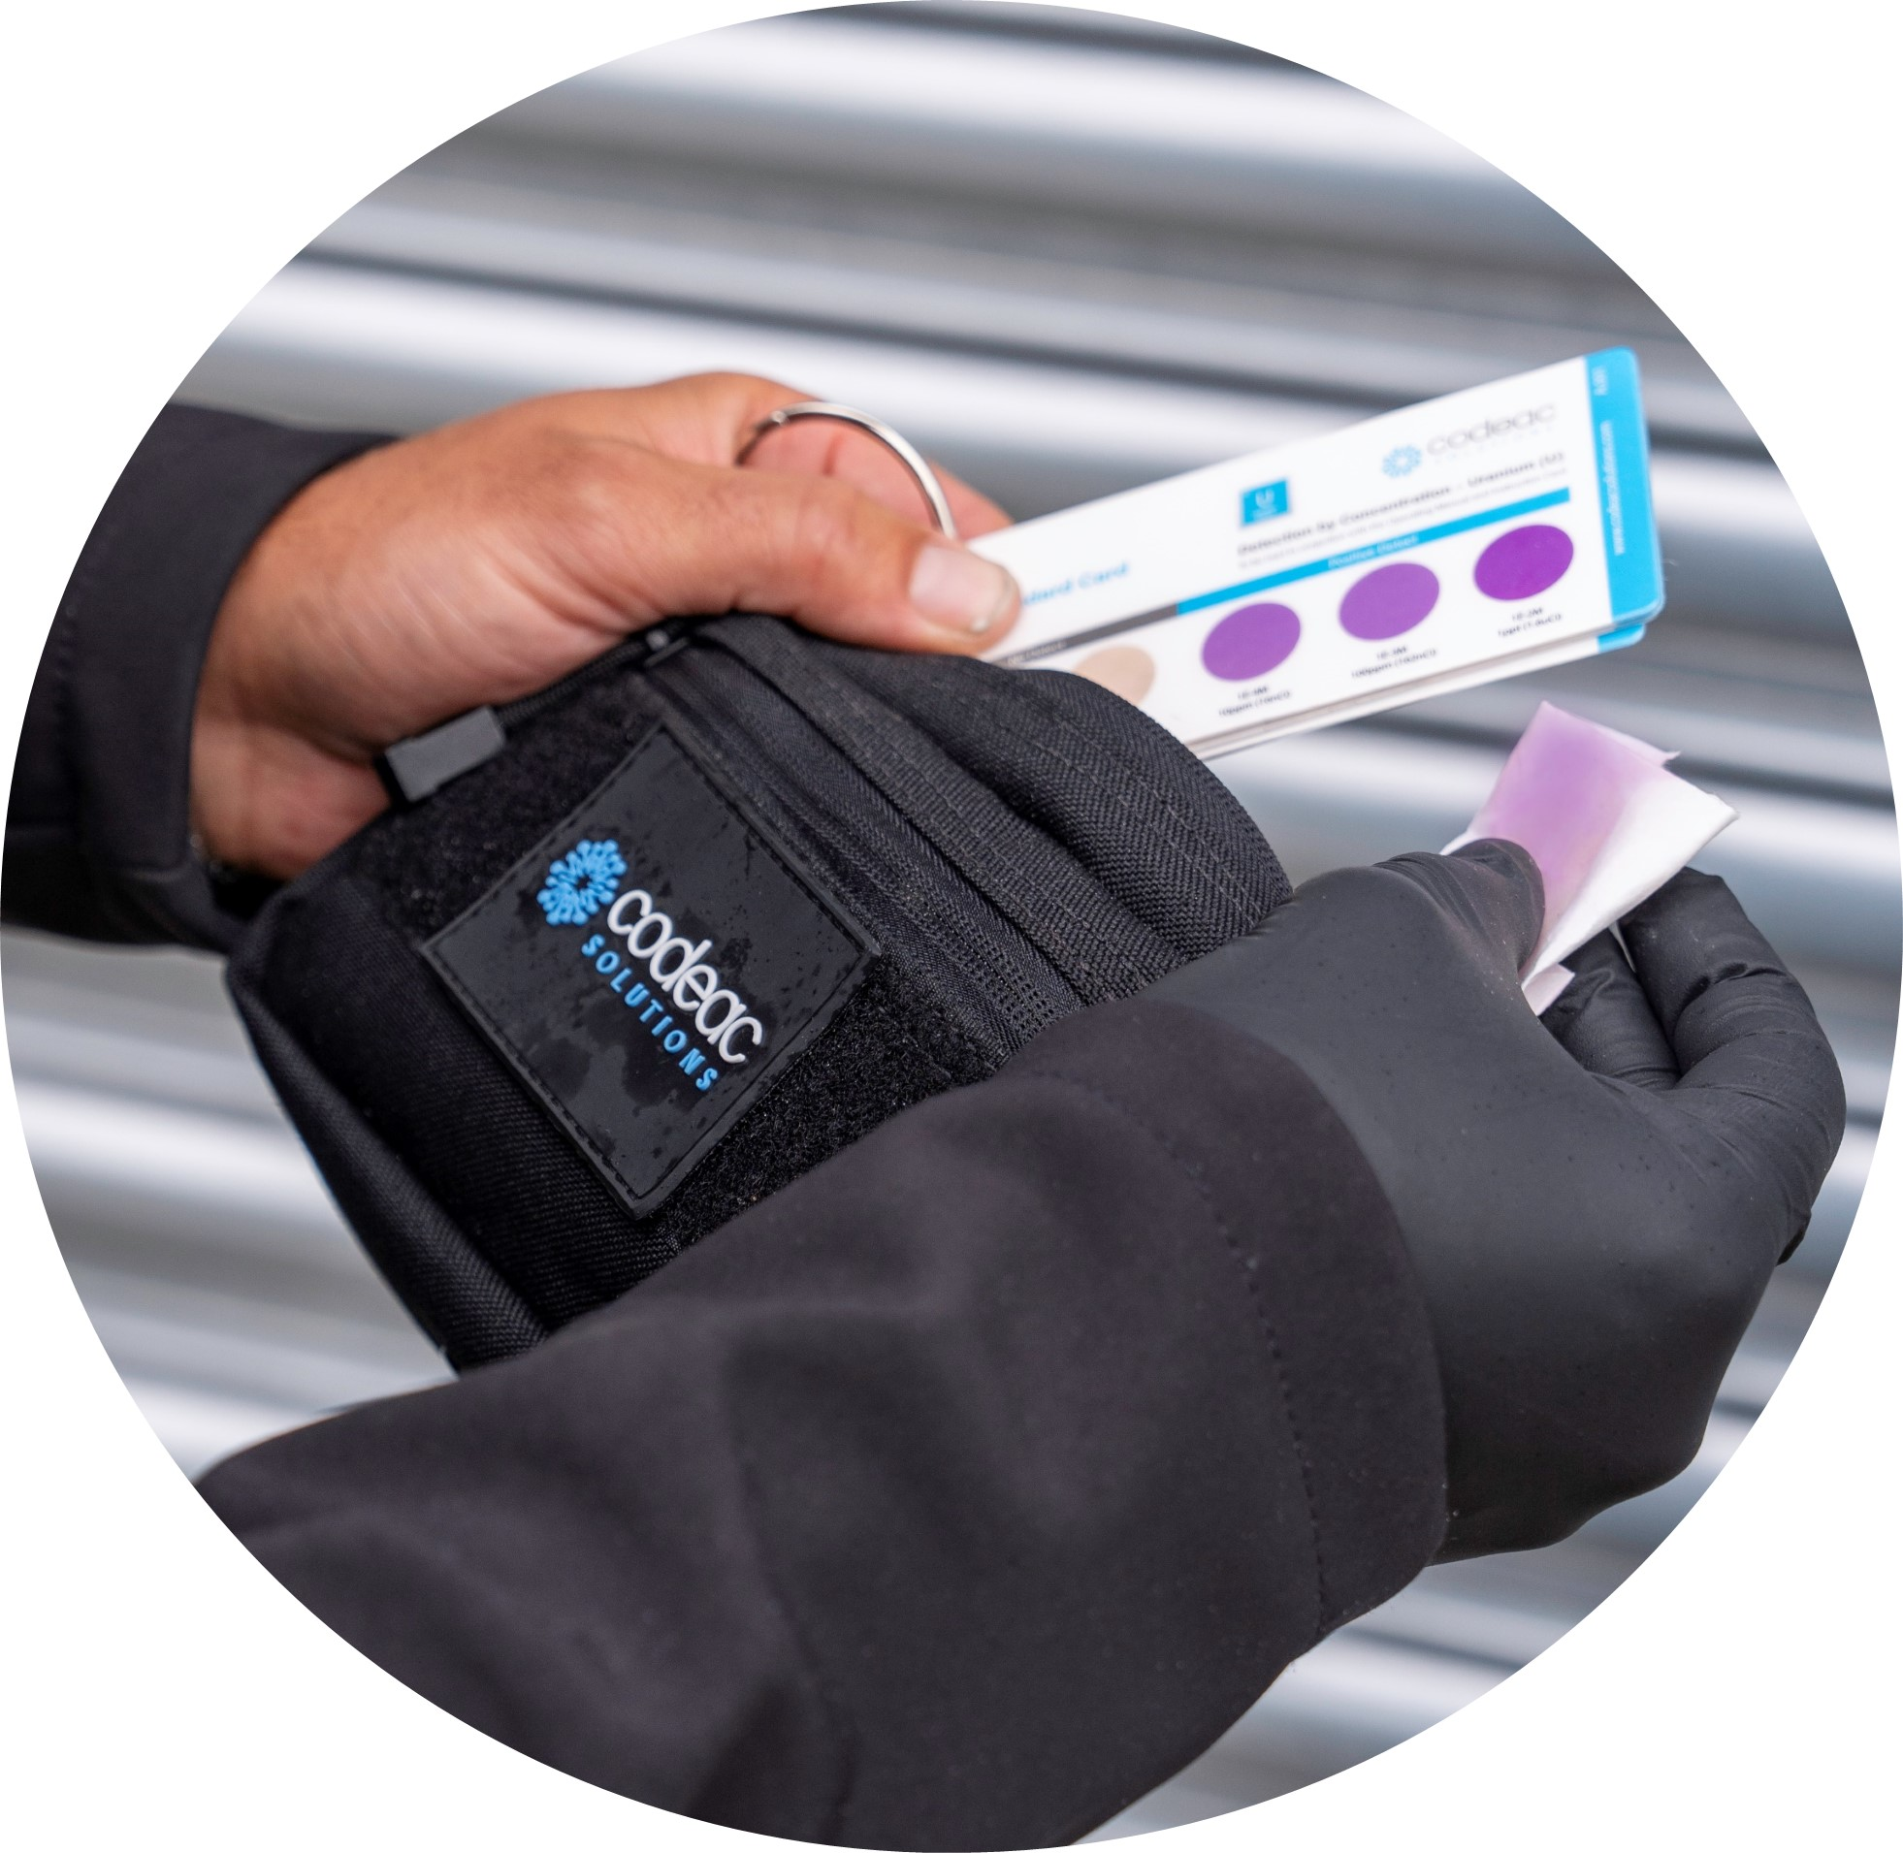
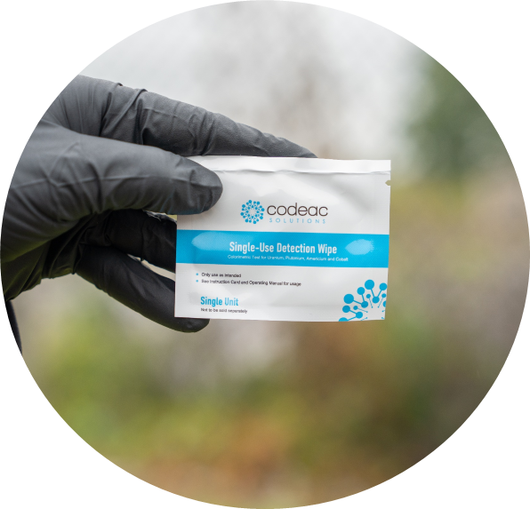
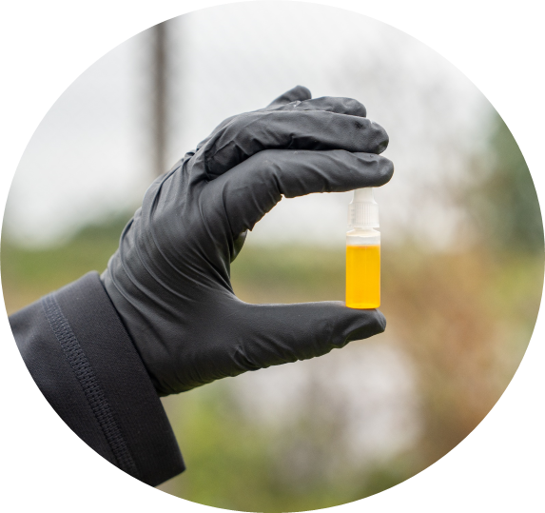
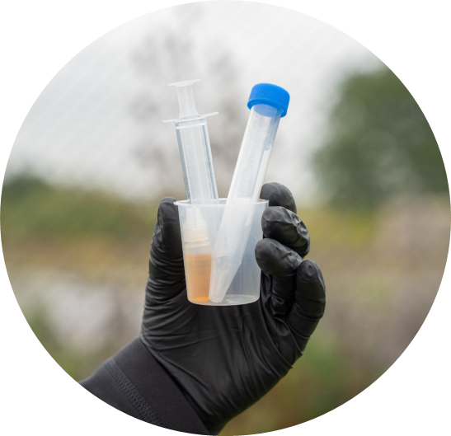
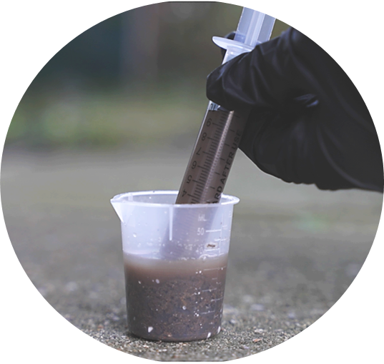
RELIABLE, FAST, RADIONUCLIDE DETECTION
We specialize in developing cutting-edge products for rapid detection and management of nuclear threats. Our technology delivers results in under 60 seconds with specificity and high sensitivity.
Our products show an immediate visual color change when in contact with Uranium, Plutonium, Americium, Cobalt and Primary Transition Metals at trace levels.
Neat
Codeac
Less than
60 seconds
U
Pu
Am
Co
Primary transition metals
OUR PRODUCT RANGE
Nuclear Detection wipe
Single Use Test
Water Test
Soil Test
contact@codeacsolutions.com
www.codeacsolutions.com

Slide 2
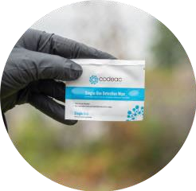
Technical specification:
SIMPLE AND EASY-TO-USE COLORIMETRIC NUCLEAR DETECTION
1
2
3
Wear appropriate PPE, as required by your organization.
Tear Single-Use Nuclear Detection Wipe, remove the wipe and collect a sample from the area suspected of contamination.
Allow 60 seconds for results and use the Color Standard to identify any colorimetric change or transition. A color change indicates a detection.
Nuclear Detection Wipes
A single-use individually wrapped nuclear detection wipe. The inner wipe is saturated with our detection liquid solution, enough for one test, with the outer foil tear protective sleeve. Available in custom sizes upon request.
Detection capability Uranium, Plutonium, Americium, Cobalt and Primary Transition Metals
e.g. U-233, U-234, U-235, U-236, U-238, Pu-239, Pu-239, Pu-241, Pu-242, Am-241, Am-243, Co-60
Detection principle Colorimetric elemental detection
Sensitivity Uranium – 2.4ppm | Plutonium – 242ppm | Americium – 2.4ppm | Cobalt – 590ppb
Dimensions Wet wipe: 8.62cm x 7cm | Field pouch: W18.5cm x H11.5cm x 7cm
Stand-up pouch: H30cm x W25cm x D12cm
Total Kit Weight (approx.) 400 grams
Color White, Black or Khaki
Amounts of tests
20 tests – 1 wipe per test
Response time Under 1 minute
Contents
20 x Nuclear Detection Wipes
4 x pairs of disposable gloves
3 x disposal bags and 5 x bags with results labels
1 x permanent marker
1 x instruction card
1 x color standard card
1 x Compact Pouch (Black, Khaki or Coyote Brown)
or
1 x Stand-up Pouch
Available accessories Replenishment kits available
Sample introduction Liquid and solid
Transportability Pocket size
Calibration Not required
Expiration 2 years
Power supply Not required
Training required Not required
Maintenance cost Nil
Manuals provided Instruction and Color Standard Card, Safety Data Sheet and Operating Manual
Products are subject to availability. Company reserves the rights from time to time, in its sole discretion and without liability to change, add or withdraw Products.
contact@codeacsolutions.com
www.codeacsolutions.com

